Slide 1
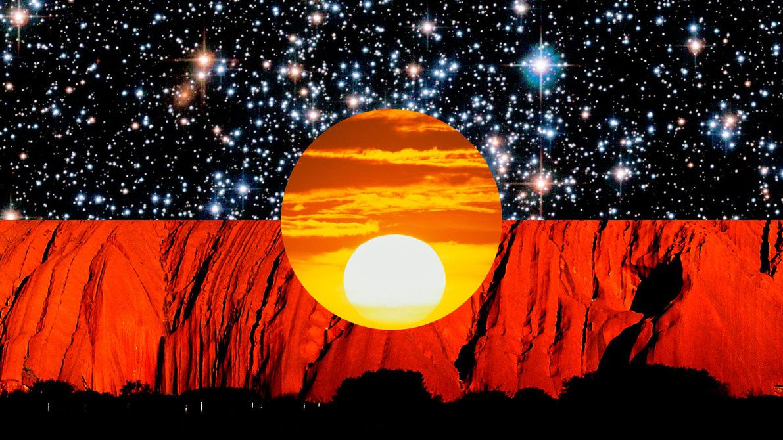
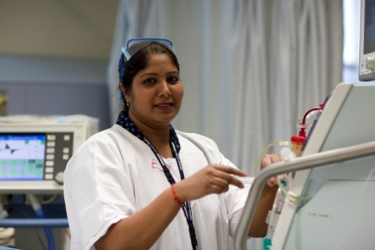
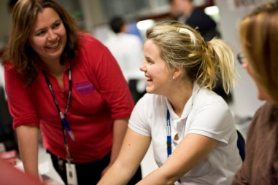
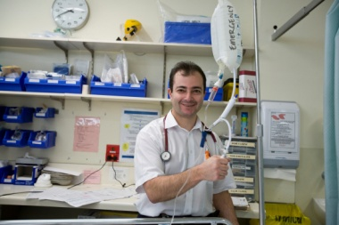
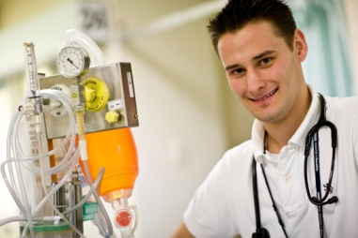
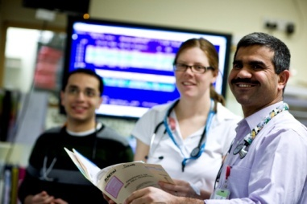
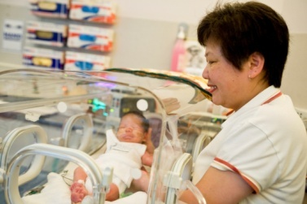
Acknowledgement of country
Notes:
I would like to acknowledge the traditional owners of the land upon which we are meeting, the Wurundjeri people and pay my respects to their elders past and present.

Slide 2
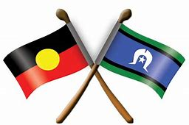
Social and Emotional Wellbeing though Aboriginal Peer and Carer support/Lived Experience at Eastern Health
Strengthening Connections
Ashleigh Bell
Aboriginal Lived experience peer worker
Notes:
Hi everyone, My name is Ashleigh Bell
I am the Aboriginal lived experience peer support worker for mental health services at eastern health
Thought I would give you a little insight as to how I ended up in this position
I am a 31 year old Wiradjuri woman and a proud mum of 4 beautiful children
Growing up, My parents were divorced and I lived with my mum till I was 15. Then I ended up with my dad who was an Alcoholic and dealing with his mental illness. I became his carer and tried my hardest to help him out as much as I could whist I had no idea what he was going through. Then I had a really bad relationship which put me into a deep depression and then I got exactly what my dad was going through. I knew how hard it was to get out of bed in the mornings. I knew how hard it was to walk out the front door and face the world. For many years not only did I try to have my own life with depression, anxiety and PTSD, raising 4 kids and running a house but I was caring for my father who would call me 5 to 10 times a day while he was at work and then help him when ever I could to get things done.
Not to long ago bills started to become harder to pay and we ended up moving in with my dad as we couldn’t pay the mortgage. Then It became my dad, my husband, my 4 kids and myself living under 1 roof. I found work at an aboriginal organisation and got the understanding about aboriginal health and how important it is for the aboriginal community to have the services available. Growing up I wasn’t in touch with my culture, I was kept away. Now that I can make my own decisions My families life revolves around our culture. With my o;ld job I wasn’t on the front line looking after community and that is all I wanted to do. I ended up coming across the position of Aboriginal Lived experience Peer Support and I jumped straight at it and applied and here I am. Helping my mob on the Front line. Showing my mob and everyone that there is hope, there is a light at the end of the tunnel. That you can recover from this.
Thank you.

Slide 3
My work in the Mental Health
Programme at Eastern Health
Notes:
I work for Eastern Health so thought I would give you some information generally about the service.
Eastern Health, Mental Health Program is a publicly funded mental health service operating within the Eastern Region of Melbourne providing mental health assessment and interventions for people experiencing mental ill health.
Working form a recovery oriented model, staff provide an array of hospital-based, community and specialist services for children, youth, adults and aged people across the Eastern Region.

Slide 4
Key facts taken from
Balit Murrup
Aboriginal Social and Emotional Wellbeing Framework
2017-2027 (DHHS)
Aboriginal Social and Emotional Wellbeing
Notes:
To set the scene of why my role is needed here are some statistics from Balit Murrup – which is the DHHS framework for Abroiginal social and emotional wellbeing.
One in three Aboriginal people experience high or very high levels of psychological distress. That is nearly three times the non-Aboriginal rate. (AATSIHS 2012–13)
Between the years 2012–13 and 2015–16 - There was a 55% increase in Aboriginal mental health-related presentations to Victorian Hospital Emergency departments.
34.8% of Aboriginal Victorians experience medically-diagnosed depression and anxiety compared with 19.6 per cent of non-Aboriginal Victorians.
Over 47 % of Aboriginal people have a relative who was forcibly removed from their family due to stolen generations policies in Victoria.
Trans-generational trauma continues to affect Aboriginal people in Victoria.
Mental health and related conditions have been estimated to account for as much as 22 per cent of the health gap (12 per cent mental health conditions, 6 per cent alcohol and substance abuse and 4 per cent suicide).
Mental health problems, self-harm and suicide have been reported at double the rate of non-Aboriginal people for at least a decade. (Burden of Disease 2003, p.2)

Slide 5
One in three Aboriginal people experience high or very high levels of psychological distress. That is nearly three times the non-Aboriginal rate. (AATSIHS 2012–13)
Between the years 2012–13 and 2015–16 - There was a 55% increase in Aboriginal mental health-related presentations to Victorian Hospital Emergency departments.
Notes:
One in three Aboriginal people experience high or very high levels of psychological distress. That is nearly three times the non-Aboriginal rate. (AATSIHS 2012–13)
Between the years 2012–13 and 2015–16 - There was a 55% increase in Aboriginal mental health-related presentations to Victorian Hospital Emergency departments

Slide 6
34.8% of Aboriginal Victorians experience medically-diagnosed depression and anxiety compared with 19.6 per cent of non-Aboriginal Victorians.
Over 47 % of Aboriginal people have a relative who was forcibly removed from their family due to stolen generations policies in Victoria.
Trans-generational trauma continues to affect Aboriginal people in Victoria.
Notes:
34.8% of Aboriginal Victorians experience medically-diagnosed depression and anxiety compared with 19.6 per cent of non-Aboriginal Victorians.
Over 47 % of Aboriginal people have a relative who was forcibly removed from their family due to stolen generations policies in Victoria.
Trans-generational trauma continues to affect Aboriginal people in Victoria

Slide 7
Mental health and related conditions have been estimated to account for as much as 22 per cent of the health gap (12 per cent mental health conditions, 6 per cent alcohol and substance abuse and 4 per cent suicide).
Mental health problems, self-harm and suicide have been reported at double the rate of non-Aboriginal people for at least a decade. (Burden of Disease 2003, p.2)
Notes:
Mental health and related conditions have been estimated to account for as much as 22 per cent of the health gap (12 per cent mental health conditions, 6 per cent alcohol and substance abuse and 4 per cent suicide).
Mental health problems, self-harm and suicide have been reported at double the rate of non-Aboriginal people for at least a decade. (Burden of Disease 2003, p.2)

Slide 8
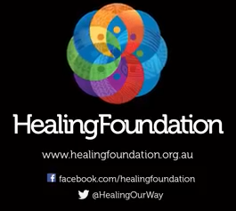
Intergenerational Trauma Animation
The Healing Foundation
https://www.youtube.com/watch?v=vlqx8EYvRbQ
Notes:
Video from Healing Foundation

Slide 9
Aboriginal Carer /Peer Support role
DHHS funded
Expanding Post Discharge Support Initiative
1 role identified Aboriginal and/or Torres Strait Islander position.
establish or re-connect with community supports.
Promote culturally safe and aware environment for Aboriginal and Torres Strait Islander consumers and carers
Part of large supportive peer workforce
Notes:
Eastern Health Mental Health Program received funds in 2016 under the Expanding Post Discharge Support initiative, funded through the state DHHS budget.
The initiative aims to reduce 28-day readmission rates by providing post discharge peer support to consumers with complex mental health needs who are discharged from an acute inpatient mental health unit and carer peer support to their family.
Through this initiative Eastern Health has opted and been able to provide a peer workforce structure that includes a focus on Aboriginal Peer Support. (THIS IS MY ROLE)
Mena was the first Aboriginal lived experience worker who commenced in 2016. She has now moved into another position which I will speak about later.
I am the second person in Victoria to hold this position.

Slide 10
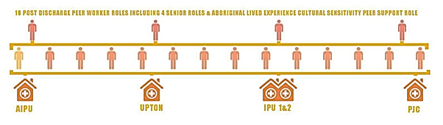
A Growing Peer-Support Workforce at Eastern Health
Notes:
4 senior peer roles
14 peer and carer peer support roles across CYMHS, adult and aged mental health inpatient services ( also inclusive of PARC services)

Slide 11
The team I work with…
Aboriginal Carer Peer worker role
2 newly appointed Aboriginal MH/ SEWB Trainees
Dedicated SEWB Team – 2 Clinicians,
1 Psychiatric Registrar and part time Consultant
Psychiatrist
Notes:
Eastern Health recently appointed two Aboriginal Mental Health trainees – Carl and Mena
Aboriginal Mental Health Traineeship program is a new workforce strategy (DHHS) that will build a mental health workforce that can provide culturally safe and inclusive mental health care for Aboriginal Victorians.
There has been 10 trainees appointed throughout Victoria in mental health services.

Slide 12
The traineeship program includes:
A three-year Bachelor of Health Science (Mental Health) Degree –
Charles Sturt University
Supervised clinical placements and workplace training over three years at the Area Mental Health Service.
Ongoing employment as a Mental Health (Social and Emotional Wellbeing) professional at the host Area Mental Health Service following successful graduation.

Slide 13
What can you do?
Notes:
I often get asked by people and services about What they can do to support Aboriginal and Torres Strait Islander consumers?
I'm supporting all the consumers I get referred but I would like to share some things that everyone could adopt at their services ….

Slide 14
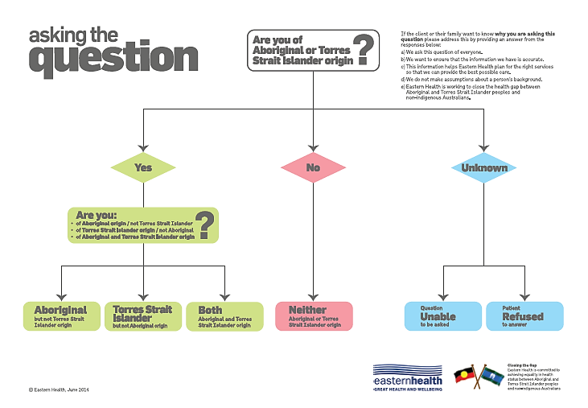
Notes:
First and foremost it is absolutely essential that everyone is asked the question about whether they identify as Aboriginal and/or Torres Strait islander.
If they are not asked then people may miss out of the types of services they need (like my role).
To note – we went over responses that EH has provided on what people could say if there were asked why they were asking this questions ….
We ask this questions of everyone
We want to ensure that the information we have is accurate
This information helps EH plan for the right services so that we can provide best possible care
We do not make assumptions about a person’s background
EH is working to close the health gap between Aboriginal and Torres Strait islander people and non-indigenous Australians.

Slide 15
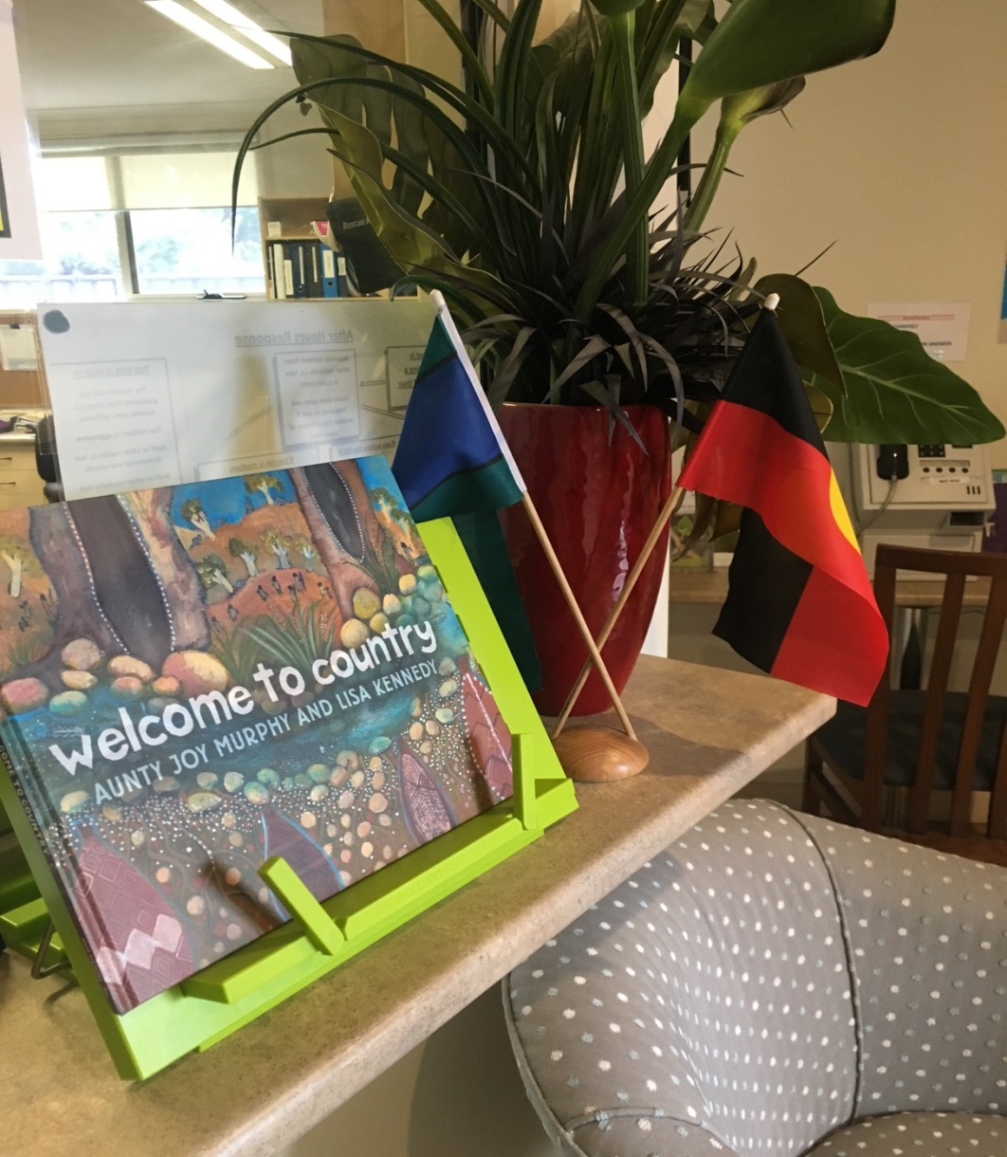
Making your environment more
culturally friendly
Notes:
Services can make improvements to the environment and make it more welcoming for Aboriginal people and their families.
This is a children's book by Wurundjeri elder Aunty Joy Murphy.
Part of and Eastern Health cultural audit requires that we have children's books that depict Aboriginal people within any service or waiting area that children may attend.

Slide 16
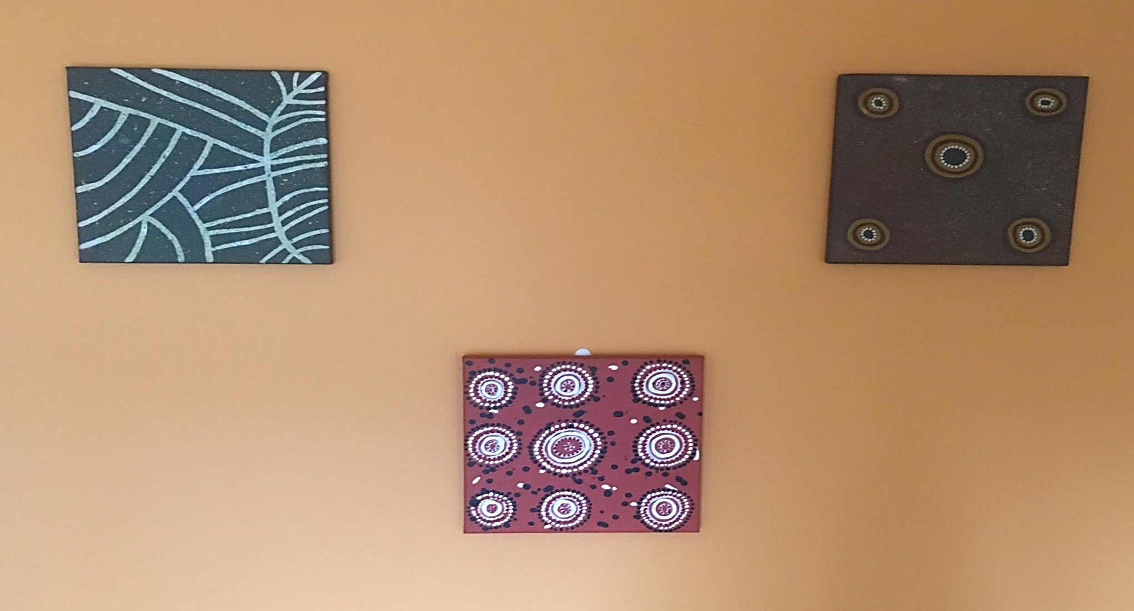
Different art works we have at Eastern Health
Notes:
Services can purchase Aboriginal art from local artists . This is Some of the aboriginal art that was purchased for one of our services.

Slide 17
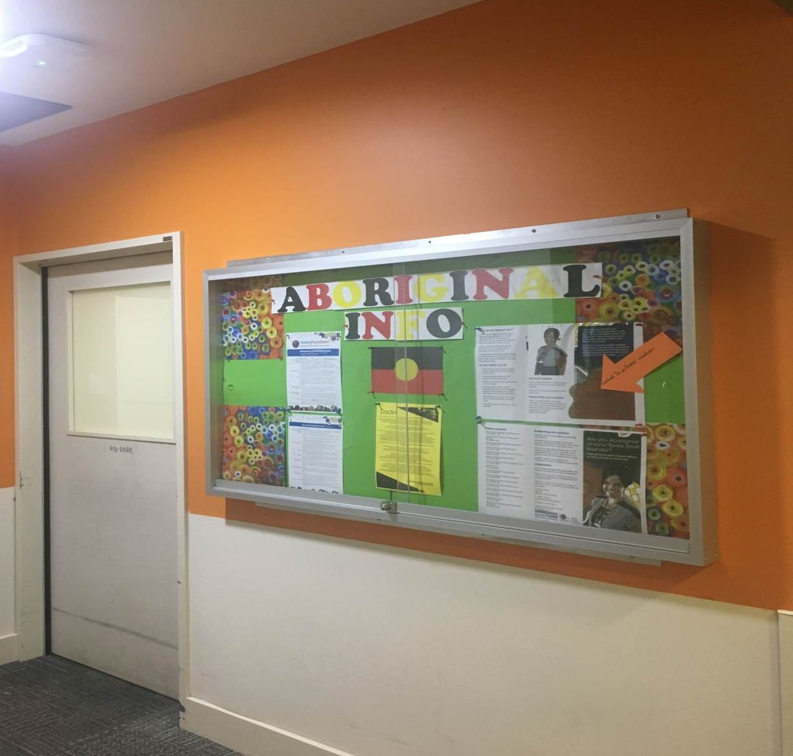
Aboriginal Information Wall IPU 1
Notes:
Provide information about Aboriginal specific services and supports
This is an Information board on one of our IPU’s
The wall behind was one of the feature walls painted by a volunteer from the Aboriginal community.
The paint was kindly donated by our local Bunning's.

Slide 18
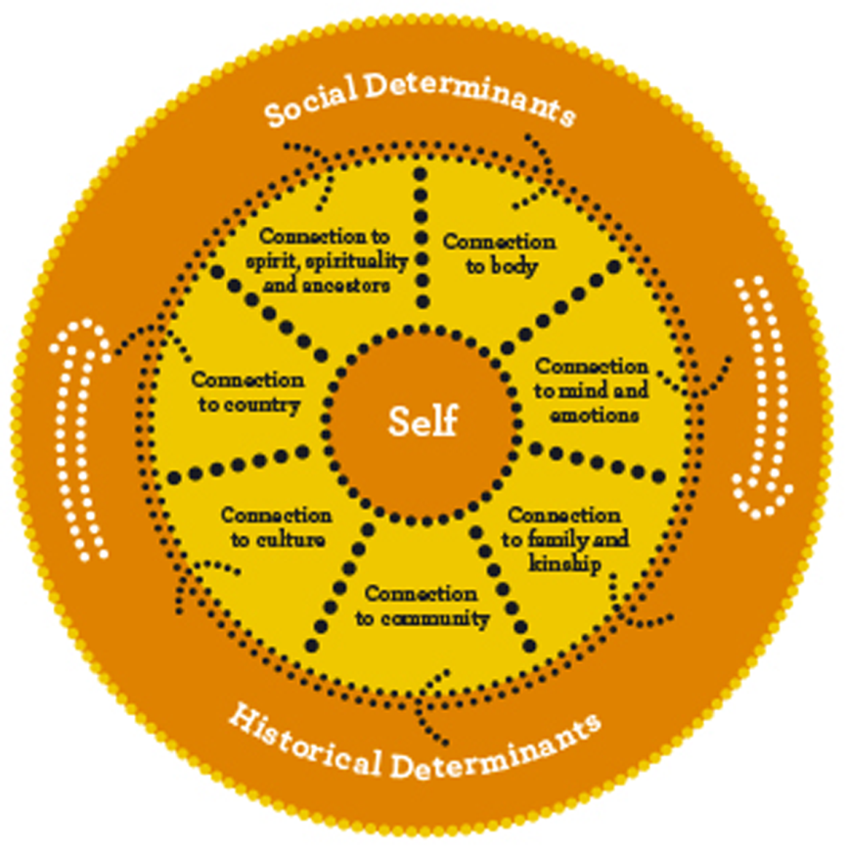
Notes:
Educate yourself or refer to a worker who understands Aboriginal Social and Emotional Wellbeing.
This diagram presents the dimension of Aboriginal Social and Emotional Wellbeing which are
-connection to spirit/spirituality and ancestors
-connection to land
-connection to culture
-connection to family and kinship
-connection to mind and emotions
-connection to body
The outer ring shows the determining influence of social, political, historical and cultural factors on social and emotional wellbeing

Slide 19
Thank you for your time ..
Questions?

